Slide 1
Yama no Kami
Alicia Cyphers
Alan Sweitzer
Andy Mrkva
Shawn Kurta

Slide 2
Overview

Slide 3
Story

Slide 4
Platform & Audience

Slide 5
Core Gameplay

Slide 6
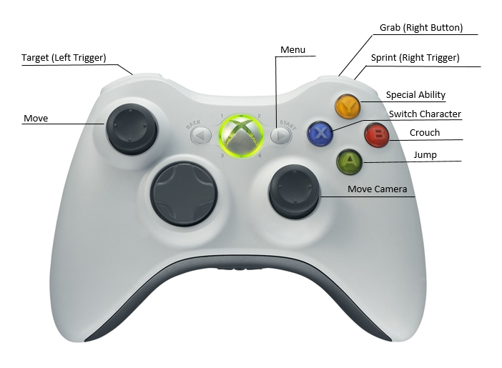
Controls

Slide 7
Level Example

Slide 8
Goals

Slide 9
Rules & Procedures

Slide 10
Resources

Slide 11
Conflict/Friction

Slide 12
Story Resolutions

Slide 13
Feedback

